Slide 1

SMART INDIA HACKATHON 2026
TITLE PAGE
Problem Statement ID – SIH26055
Problem Statement Title- Smart Scan Strategy for Electronic Warfare
Theme- Robotics and Drones
PS Category- Software
Team ID-
Team Name- CodeSutra

Slide 2
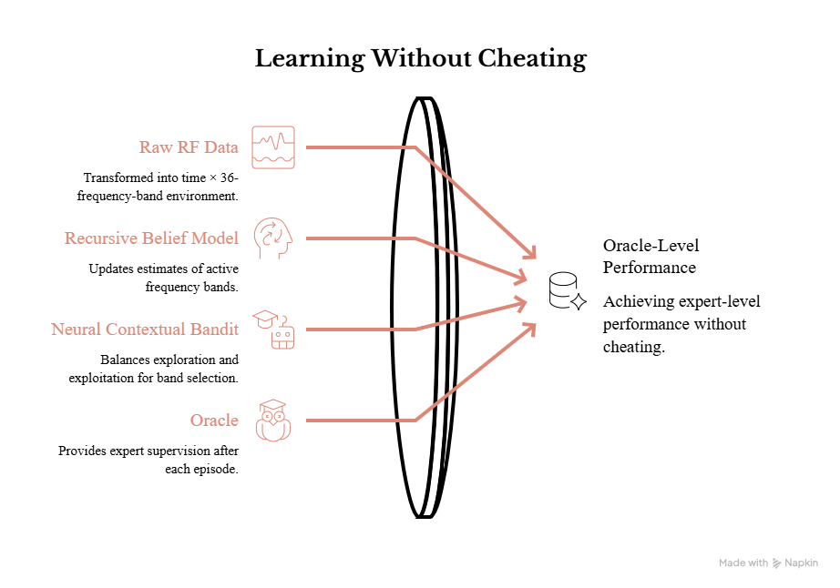


Smart Scan Strategy for Electronic Warfare
CodeSutra
Adaptive RF Spectrum Scanning with Oracle-Guided Neural Bandits

Slide 3
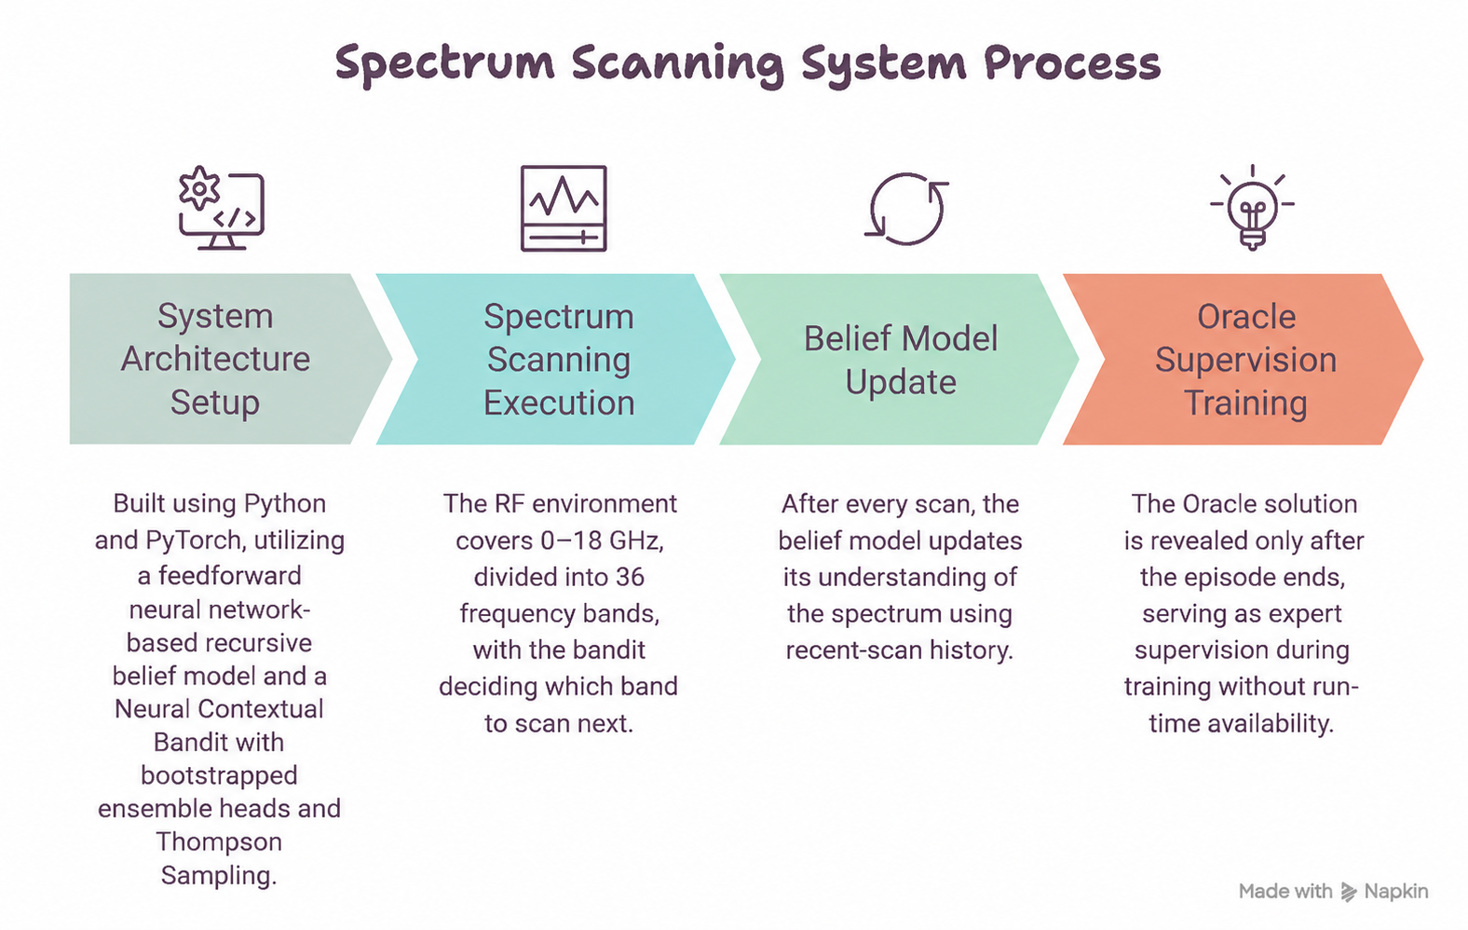

TECHNICAL APPROACH
CodeSutra
@SIH Idea submission
3

Slide 4
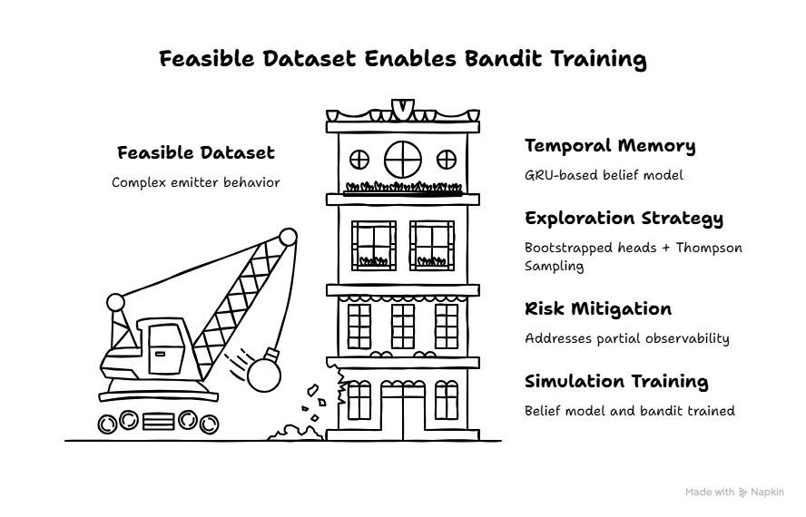
FEASIBILITY AND VIABILITY
CodeSutra

Slide 5

IMPACT AND BENEFITS
CodeSutra

Slide 6
RESEARCH AND REFERENCES
CodeSutra
Contextual bandits and Thompson Sampling for sequential decision-making under uncertainty
Recurrent belief-state (GRU) models for partially observable spectrum-sensing environments
Oracle-guided expert supervision / imitation learning for policy training
Electronic Warfare literature on frequency-agile emitter scanning and spectrum surveillance.

